Slide 1
Investigating Netflix Stock Data
By Kseniia Mozgovaia

Slide 2
The presentation is contained visualisation and analysis of Netflix stock Data in the 2017 year
The distribution of the stock prices for the 2017 year
Netflix's earnings and revenue in the last four quarters
The actual vs. estimated earnings per share for the four quarters in 2017
A comparison of the Netflix Stock price vs the Dow Jones Industrial Average price in 2017

Slide 3
The distribution of the stock prices for the 2017 year
A stock (also known as equity) is a security that represents the ownership of a fraction of a corporation. This entitles the owner of the stock to a proportion of the corporation's assets and profits equal to how much stock they own. Units of stock are called "shares."
Stock has Price, which is estimated by marketplace. It is a company value per share.
Share is a unit of stock, of ownership of a Company.

Slide 4
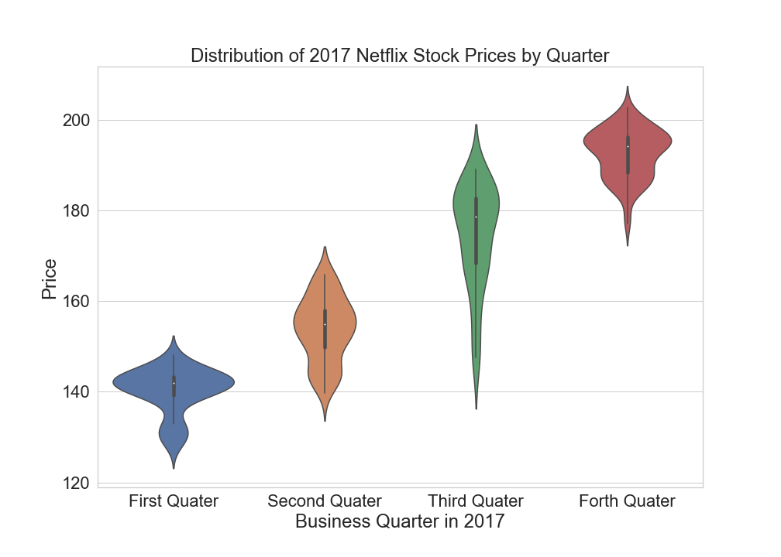
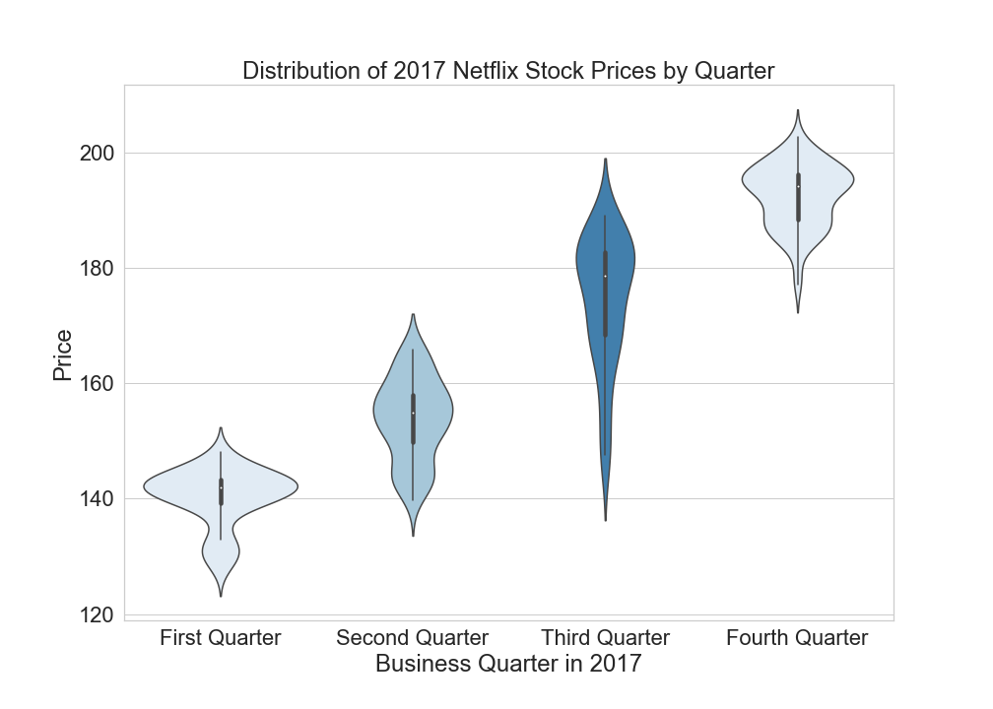
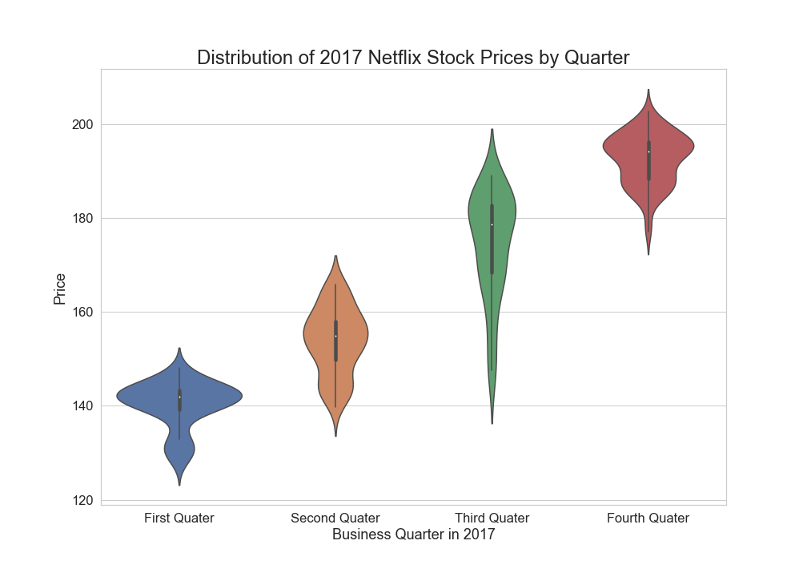

Slide 5
Interpreting violin graph
On graphic there is seems obvious increasing price tendency, where in first quarter it was started with 120 USD as minimum and in the fourth quarter ended with over 170 USD as minimum. In first, second and fourth quarters graphic are bi-modal, where more than half population distributed near average price.
Most of the year from first to fourth quarter price was in range of 135 - 170 USD.
Minimum of the whole 2017 year observation is 127 USD in first quarter.
Maximum of the whole 2017 year observation is 203 USD in the fourth quarter.

Slide 6
The actual vs. estimated earnings per share for the four quarters in 2017
Earnings per share (EPS) is a company's net profit divided by the number of common shares it has outstanding.
EPS indicates how much money a company makes for each share of its stock and is a widely used metric for estimating corporate value.
The higher a company's EPS, the more profitable it is considered to be.
Market makes its estimation about EPS, and after closure form an actual EPS.
We are going to look at this relation for Netflix.

Slide 7
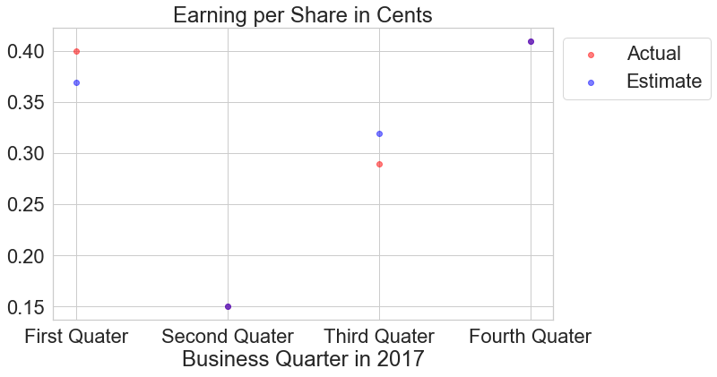

Slide 8
Interpreting scatter graph
As it shows on scatter graph indicated by purple dots in second and fourth quarters was estimated EPS and actual EPS were the same, prediction was accurate. Where in first quarter actual EPS was underestimated and in third quarter was overestimated.

Slide 9
Netflix's earnings and revenue in the last four quarters
Revenue is the total amount of income generated by the sale of goods or services related to the company's primary operations.
Earnings refer to a company's profits in a given quarter or fiscal year.It shows a company's real profitability compared to the analyst estimates.
In simple terms, revenue is the income a business generates when it provides a service or a product to a consumer. Earnings, on the other hand, are the inflow of money after all the expenses, i.e., profit from a business in their daily operations. It is the amount earned by a business from their day to day activities.

Slide 10
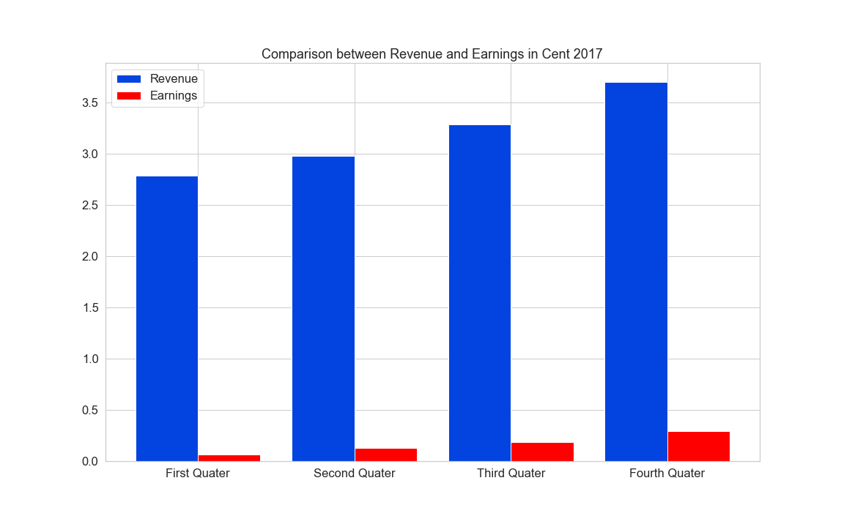
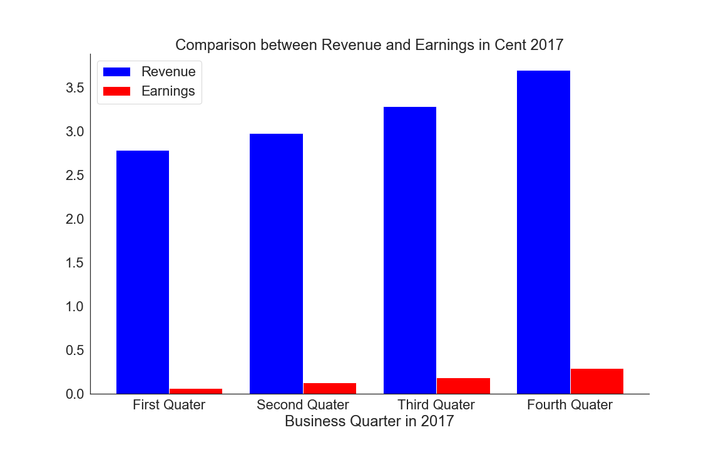
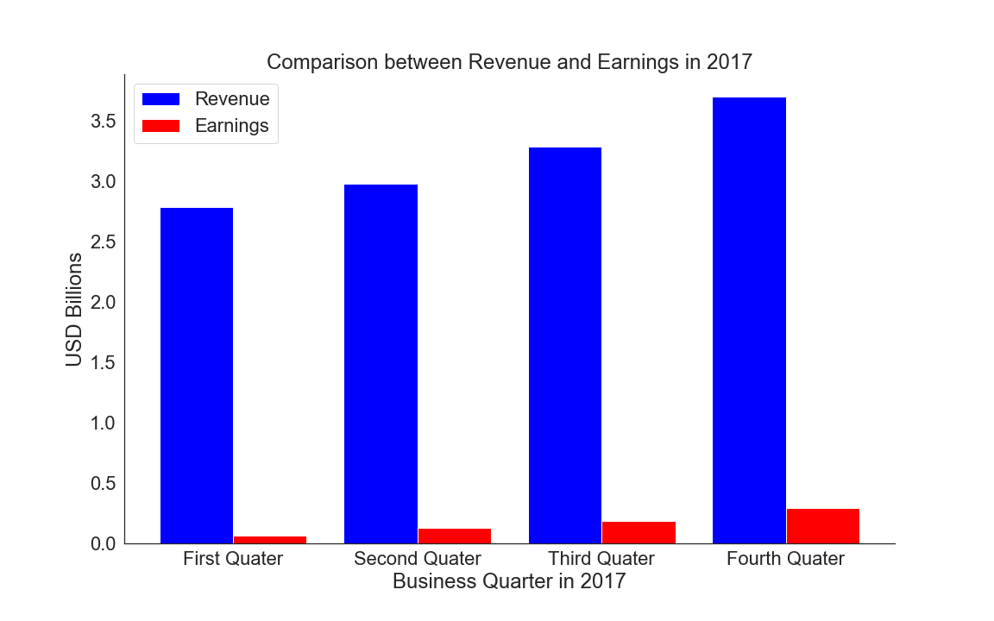


Slide 11
Interpreting bar chart
Revenue is following an increasing trend, raising it value on 24%.
Earnings is also following an increasing trend, raising it value on 77%
Average revenue constitutes 0.05% average earnings.

Slide 12
A comparison of the Netflix Stock price vs the Dow Jones Industrial Average price in 2017
The Dow Jones Industrial Average (DJIA) is a widely-watched benchmark index in the U.S. for blue-chip stocks.
The DJIA is a price-weighted index that tracks 30 large, publicly-owned companies trading on the New York Stock Exchange (NYSE) and the Nasdaq.

Slide 13
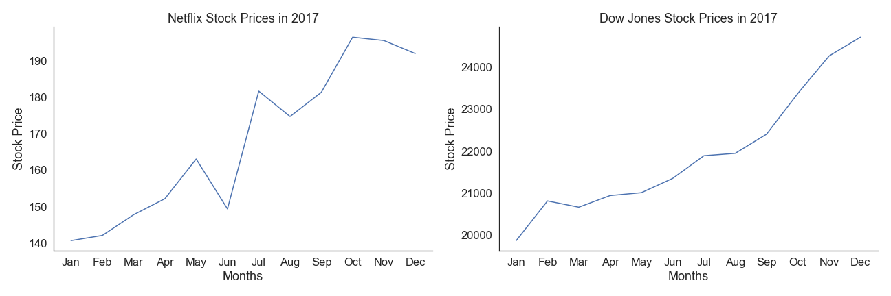

Slide 14
Interpreting two line plots
Netflix stock price is more convoluted, in June was a fail, but other than that it had increasing tendency till October, where it slight decrease.
Despite of convoluted graphic, DJAs volatile is much higher than Netflix volatile.
Compare with Dow Jones Average graphic, the maximum Netflix stock price of 195 USD and the minimum DJAs stock price of 20 000 USD is lower in 102 times.

Slide 15
Summary
Netflix came a long way from a small streaming service, to service that provide world known and acclaimed movies and TV series, moretheless its remarkable success shows in marketplace. To nowadays stock price is higher on 308% compare to the maximum price of 2017 year. It is still far from Dow Jones Average, yet Netflix is the most watchable streaming service, and presumably will not stay on a one place. Therefore my suggestion is to invest carefully for a short term, look for shows that could bring more attention to this platform.

Slide 16
References:
https://www.codecademy.com
https://www.investopedia.com
https://www.marketwatch.com/investing/stock/nflx
Financial Data Source: Yahoo Finance

Slide 17
Thank you for your attention!

